Slide 1
Zurich Dogs
2015
The Who, Where, What

Slide 2
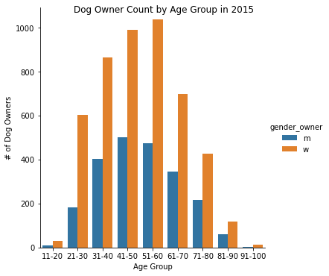
The Who? Men vs. Women? Age vs. Youth?
Across all age groups,
female owners outnumber males.

Slide 3
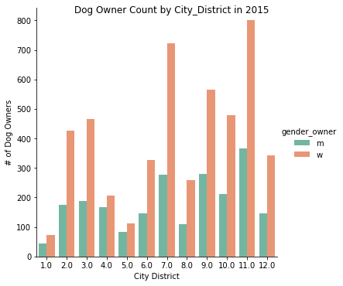
Where in Zurich?
Women comprise the majority of
Dog owners in all Zurich City Districts

Slide 4
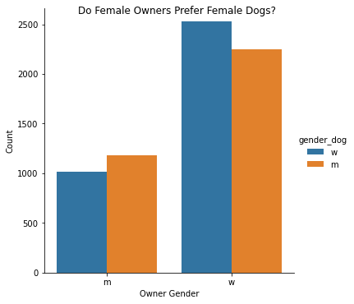
What kinds of dogs?
Female owner slight preference for
female dogs.
Male owners have slight preference
for male dogs.

Slide 5
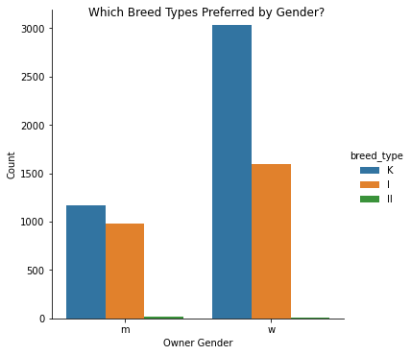
Women prefer smaller dogs
Smaller dogs, ‘K-type’, preferred by
women by large margin

Slide 6
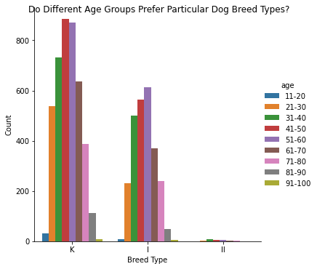
Smaller Dogs Preferred Overall by All Age Groups
For medium size dogs, 51-60 age
group is largest.

Slide 7
Understanding the Zurich Dog Owner Environment:
Small female dogs owned by women represent the largest group of dogs in Zurich.
Female owners outnumber male owners in all Zurich City District. Districts 7 and 11 have the largest difference, almost 2:1 female to male owners.
Female owners outnumber male owners in all age groups.
The largest owner age group is the 51-60 year old.
Second largest owner age group is the 41-50 year old.

